Slide 1
Python 進階程式設計
張家瑋 博士
助理教授
國立臺中科技大學資訊工程系

Slide 2
Socket programming -TCP/UDP (I)

Slide 3
Outline
simple http server
proxy web request
spoof_mozilla_firefox_in_client code
echo server by TCP
echo client by TCP
echo server by UDP
echo client by UDP

Slide 4
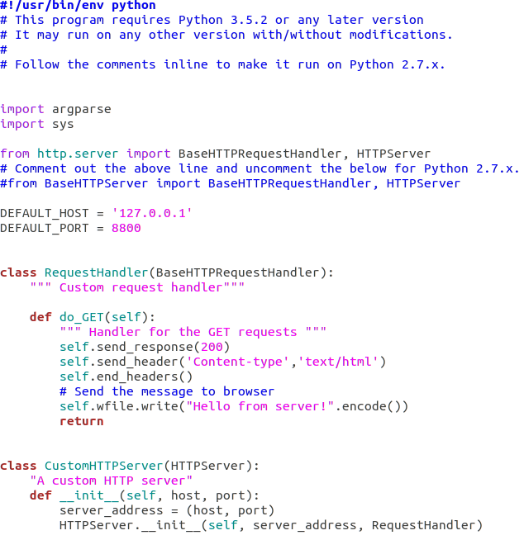
simple_http_server

Slide 5
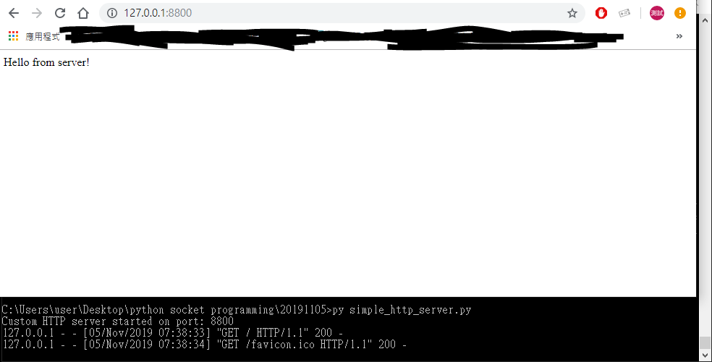
simple_http_server

Slide 6
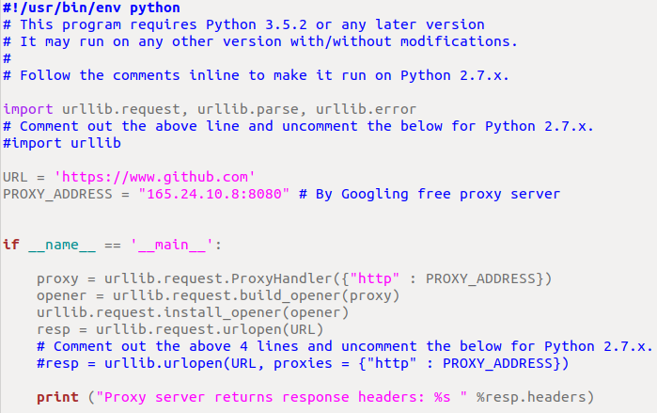
proxy_web_request

Slide 7
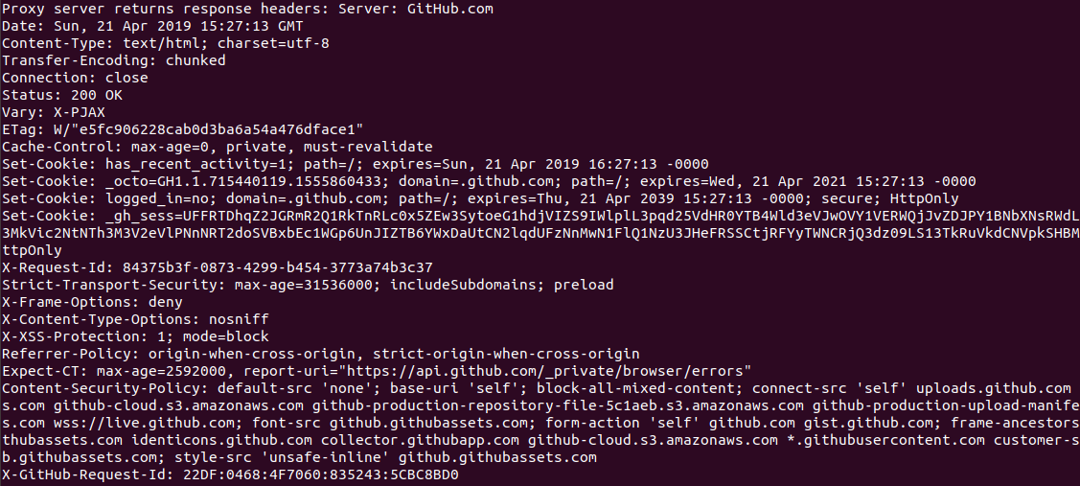
proxy_web_request

Slide 8
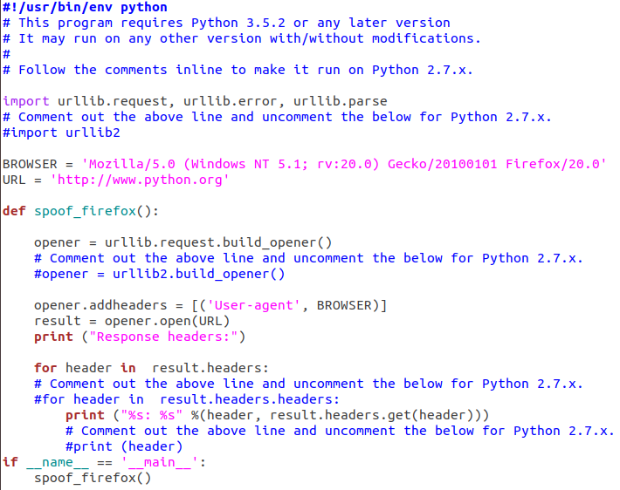
spoof_mozilla_firefox_in_client code

Slide 9
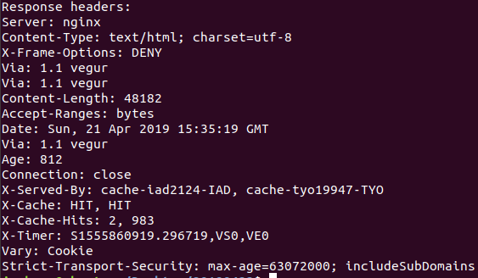
spoof_mozilla_firefox_in_client_code

Slide 10
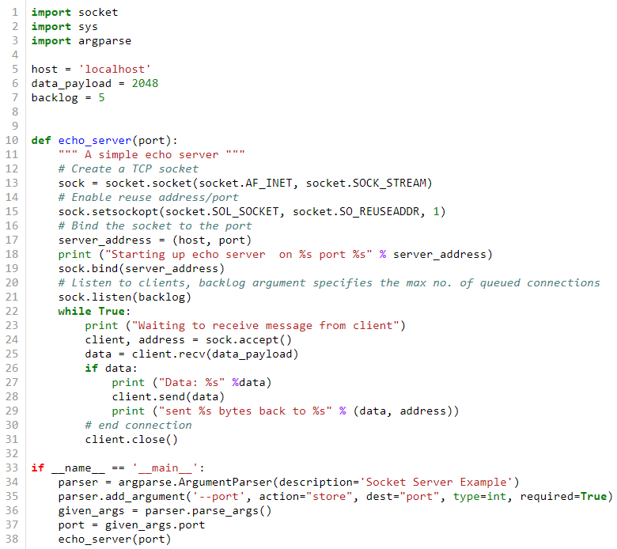
echo_server by TCP
python echo_server_TCP.py --port=<PORT>

Slide 11
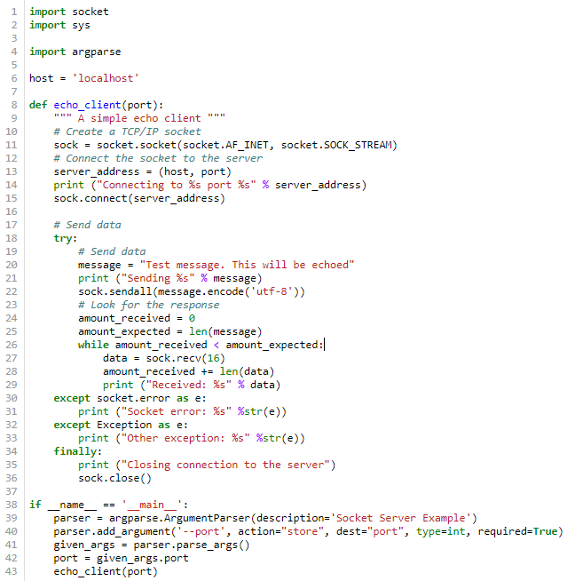
echo_client by TCP
python echo_client_TCP.py --port=<PORT>

Slide 12
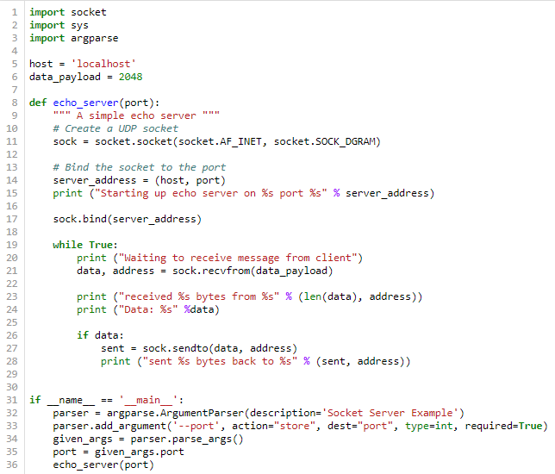
echo_server by UDP
python echo_server_UDP.py --port=<PORT>

Slide 13
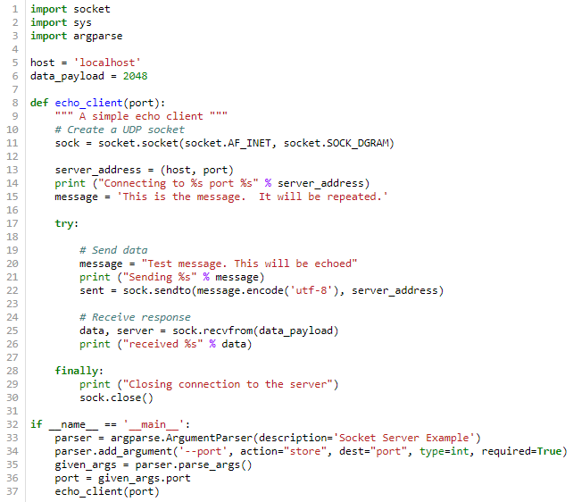
echo_client by UDP
python echo_client_UDP.py --port=<PORT>

Slide 14
延伸閱讀
Socket Programming in Python (Guide)
https://realpython.com/python-sockets/#socket-api-overview
Python 网络编程
http://www.runoob.com/python/python-socket.html

Slide 15
Thanks
Resource is available by https://jiaweichang.github.io/biography/

